Slide 1
Weekly Meet Feb 26
JetRacer Soccer League

Slide 2
LiDAR (Arjun, Jarod)
Previous Work
Began work on report
Looked into Zed documentation and helped test depth sensing
Worked on finding field location
Future Work
Continue to help test and integrate Zed cameras

Slide 3
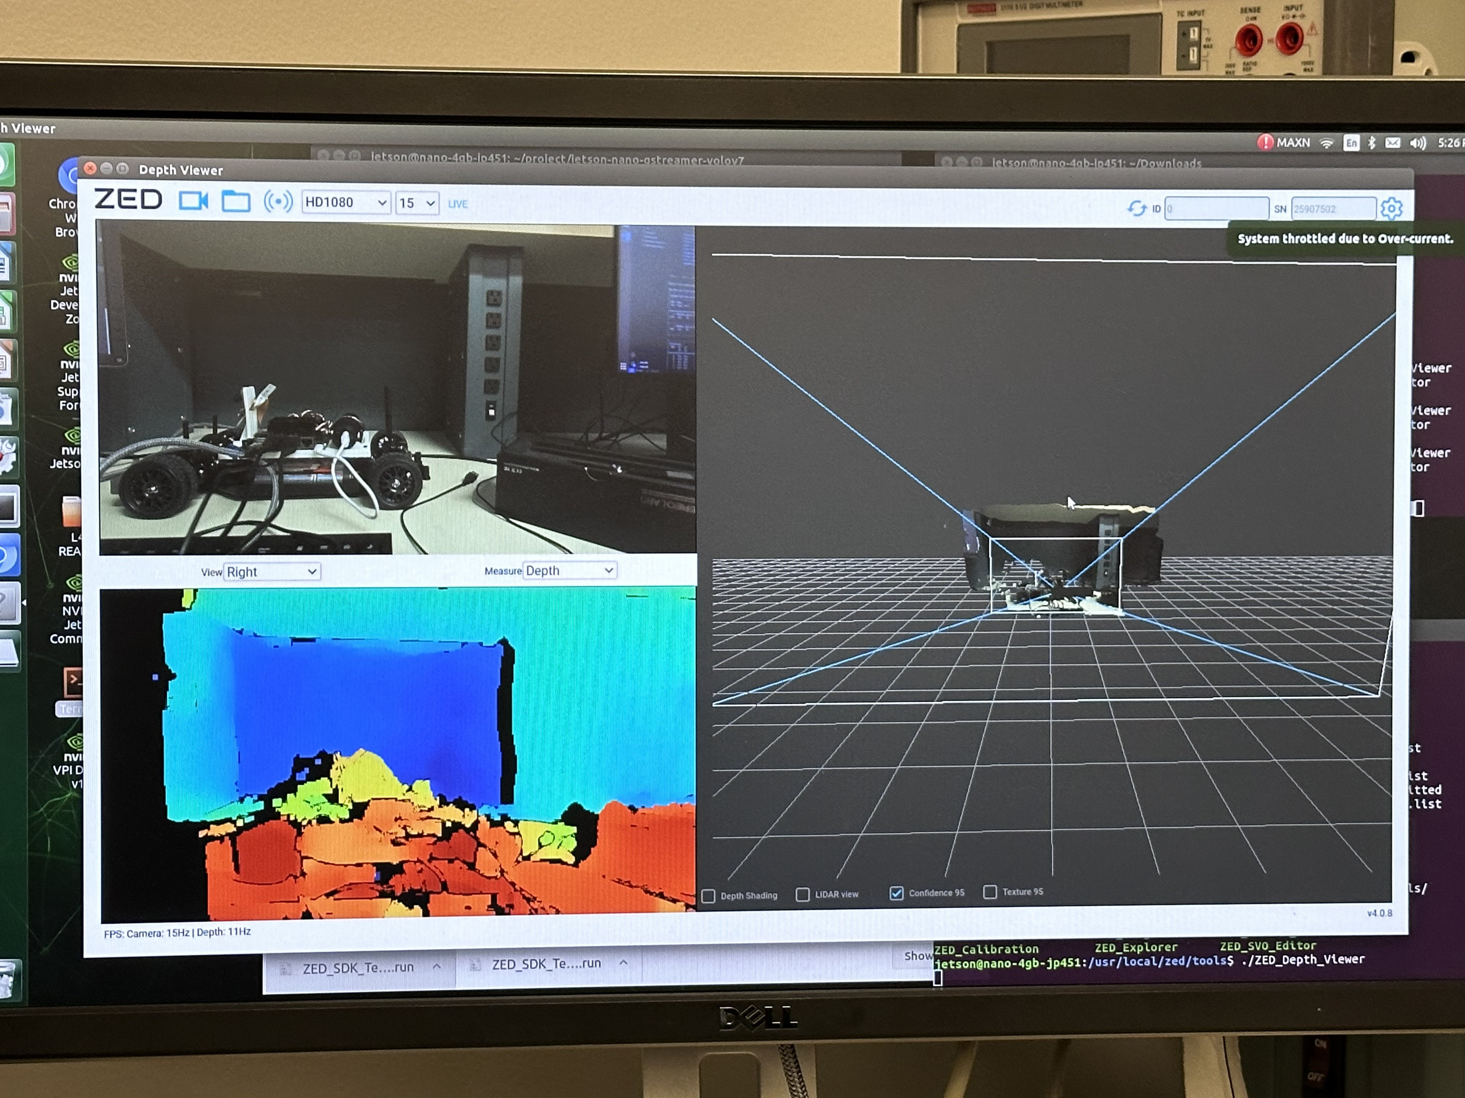
Computer Vision (K, Julie)
Previous work:
Tested Zed2 capabilities
Tested object detection libraries
Repurposing YOLOv8 trainer for Jetracer
Future work:
Train yolov8 model while waiting for Zed2 to arrive
Work with ROS team to set up publisher and subscriber for steering servo
Test steering towards ball position
Test ball following (with throttle)

Slide 4
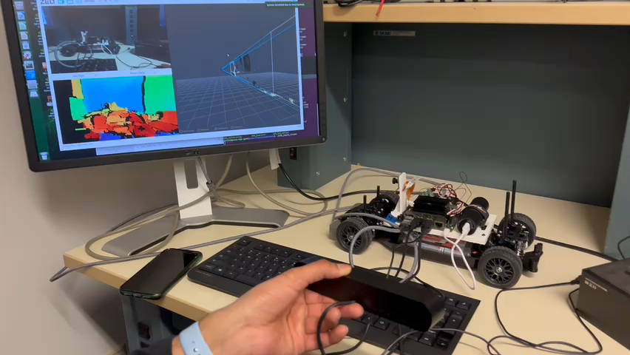

Slide 5
ROS (Casey, Cooper)
Previous Work
Finalized CAD
Fixed issue with Adafruit Servo Module
Implemented Zed2 servo control in ROS package
Created ROS launch file
Future Work
Implement a controller for better servo control
Continue to flash SD cards with 20.04 (migrate current work)
Read through ZED documentation so we are ready once it arrives
Create structure to integrate ZED

Slide 6
Unity (Mason)
Previous work:
Unity Simulation for the RC cars including collecting the 1v1 and 2v2 field data.
Created a 3rd year GitHub page for the JetRacer project.
Future work:
Continue to document the project in the Github page.
Setting aside the Unity integration at the moment and help whatever is needed in the hardware aspect of the project.
Github link:
https://github.com/Masonry11/JetRacer-Soccer-League-Year-3

Slide 7
Questions

